Slide 1



Lock-in-Thermography
Presented by: Neeraj Tiwari
Guide: Dr. Deepak Mishra, Saurabh Sir(phd), Hari Krishnan Sir (ISRO)
Indian Institute of Space Science and Technology

Slide 2
Table Of Content:
Introduction
Lock-in Thermography
Thermal IR Camera
Software Required for Camera interface
Algorithm for Defect Detection
Result

Slide 3
INDRODUCTION
The thermal radiation spontaneously emitted by many ordinary objects can be approximated as black-body radiation. ​
​
Unlike visible light, in the infrared world, everything with a temperature above absolute zero emits heat. Even very cold objects, like ice cubes, emit infrared. And visible light doesn't affect the thermal world.

Slide 4
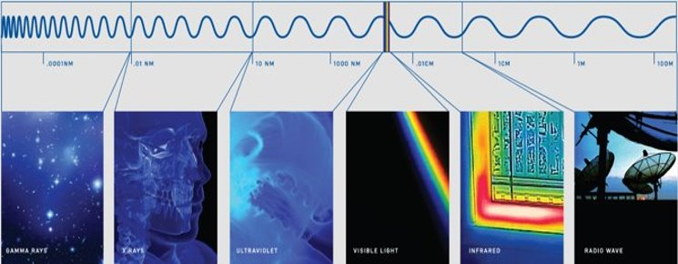

Slide 5
Lock-in Thermography
he principle of lock-in thermography is based on the application of a periodic input energy wave (i.e. thermal emitter, ultrasound, microwave, eddy current, flash lamp) to the surface of the object being examined and analyzing the resulting local temperatures on the surface of the object.
When the input energy wave penetrates the object’s surface, is it absorbed and phase shifted. When the input wave reaches areas within the object where the thermophysical properties are not homogeneous in relation to the surrounding material, (i.e. at delaminations or inclusions), the input wave is partially reflected.

Slide 6
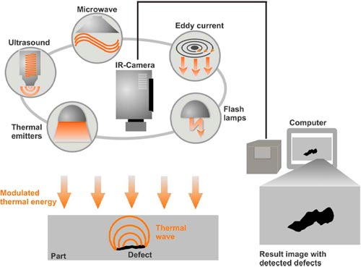


Slide 7
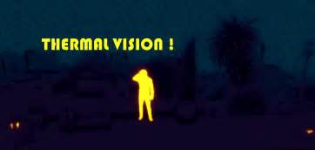
Thermal IR Camera
Infrared Energy Detection
An infrared camera is a non-contact device that detects infrared energy (heat) and converts it into an electronic signal, which is then processed to produce a thermal image or video, on which you can perform temperature calculations.
Heat sensed by an infrared camera can be very precisely quantified, or measured, allowing you to not only monitor thermal performance, but also identify and evaluate the relative severity of heat-related problem

Slide 8
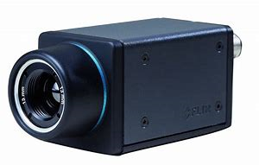
FLIR Ax5-Series
FLIR A35 Technical Specifications:
IR resolution 320 × 256 pixels
Image frequency 60 Hz
Detector pitch 25 µm
Thermal sensitivity 50 mK
Ethernet Power over Ethernet

Slide 9
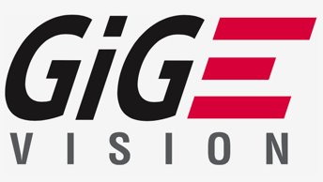
Camera Interface Software
The GigE Vision® standard defines communications protocols for data transfer over Ethernet connections. Image Acquisition Toolbox™ supports digital cameras that follow the GigE Vision standard.
By supporting GigE Vision within MATLAB® and Simulink®, users are able to integrate standard cameras into their workflows to capture live video and images for processing.

Slide 10
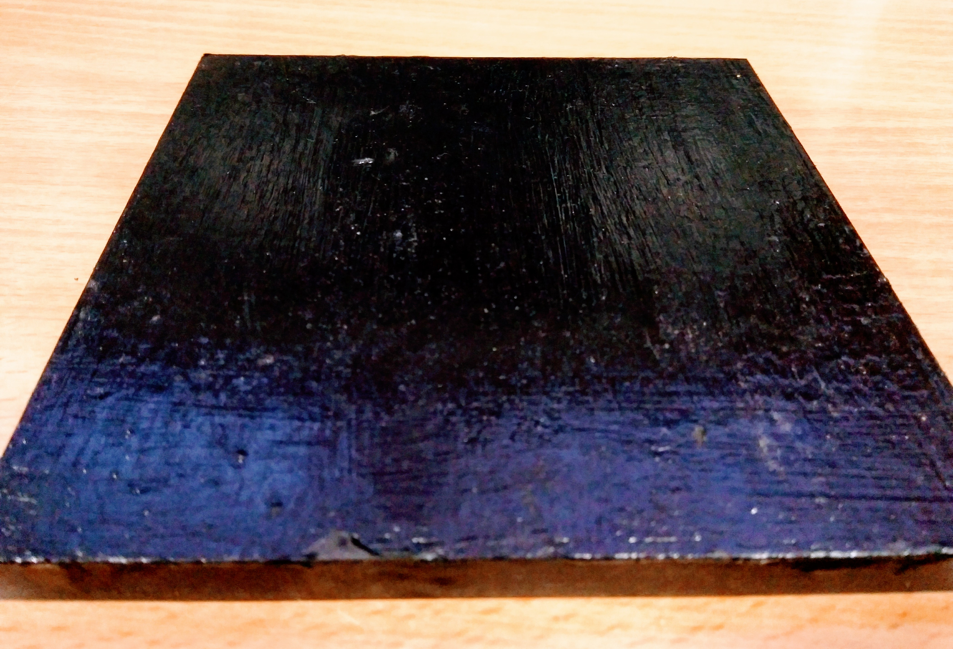
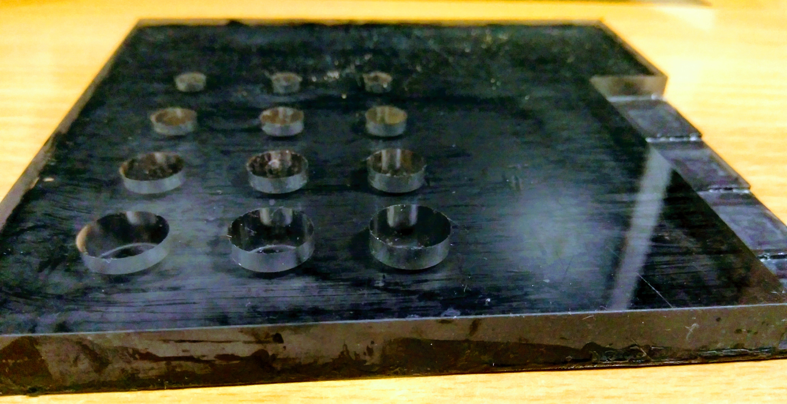
Defected Material
Front View
Back View

Slide 11
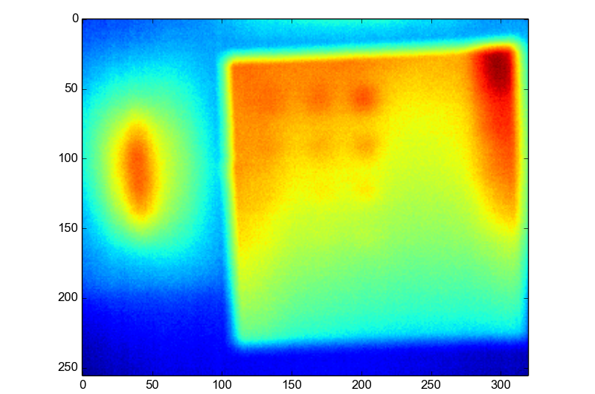
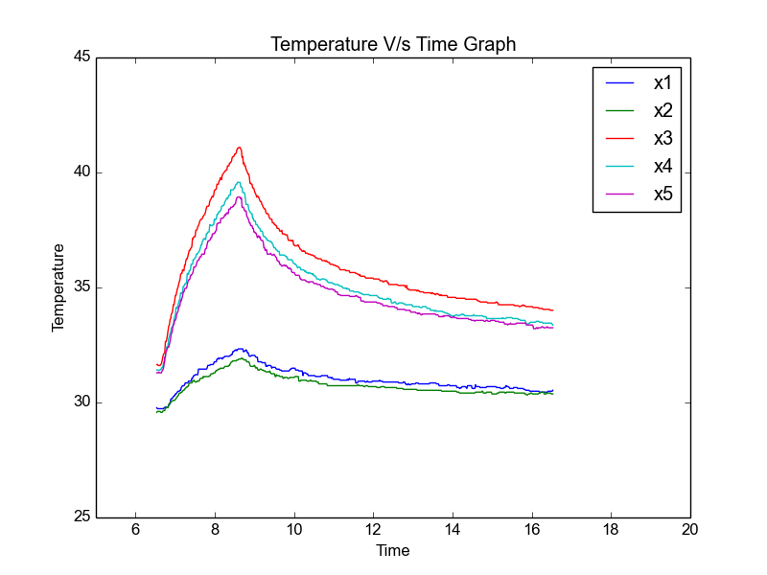
Result

Slide 12
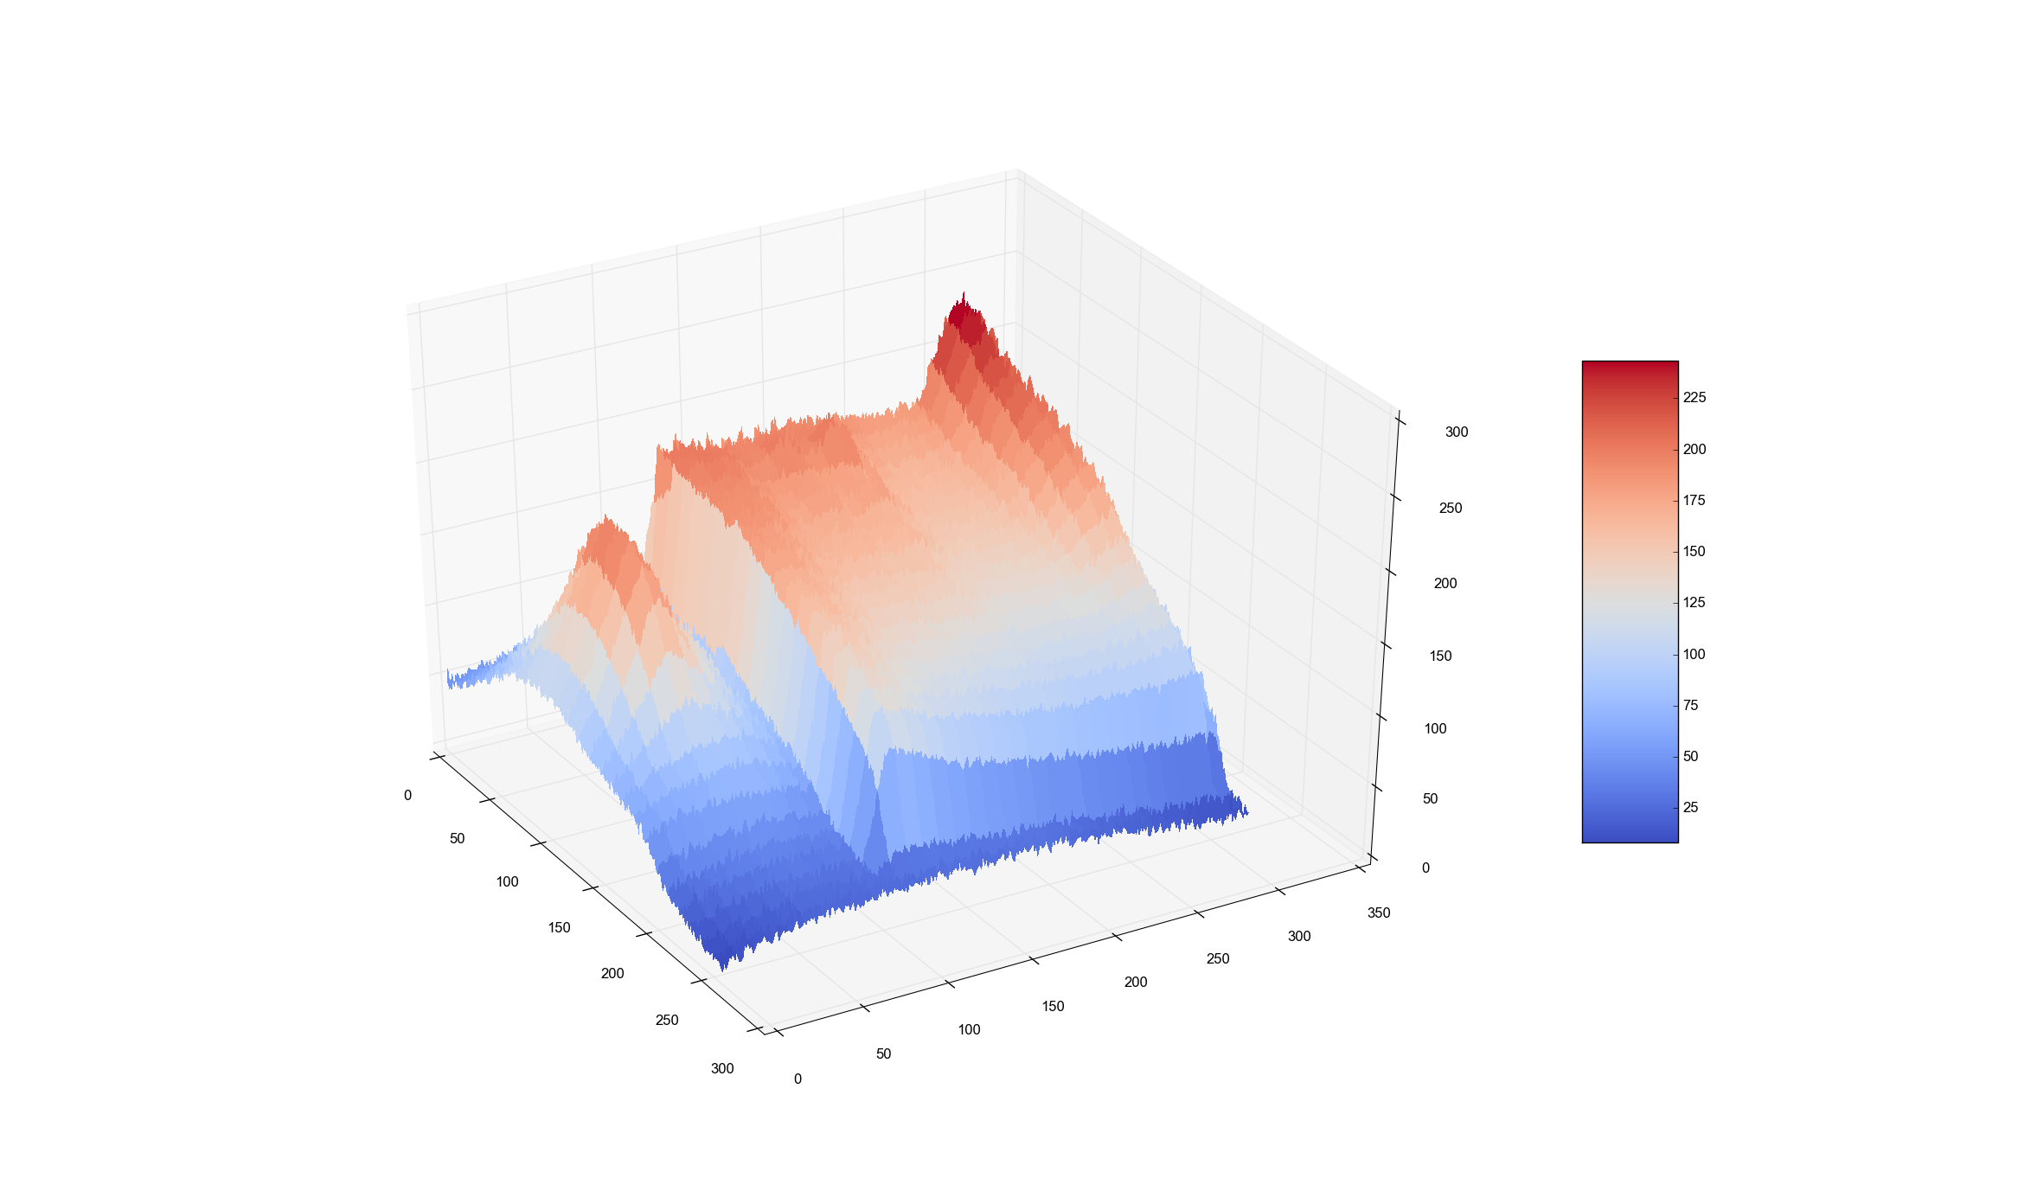
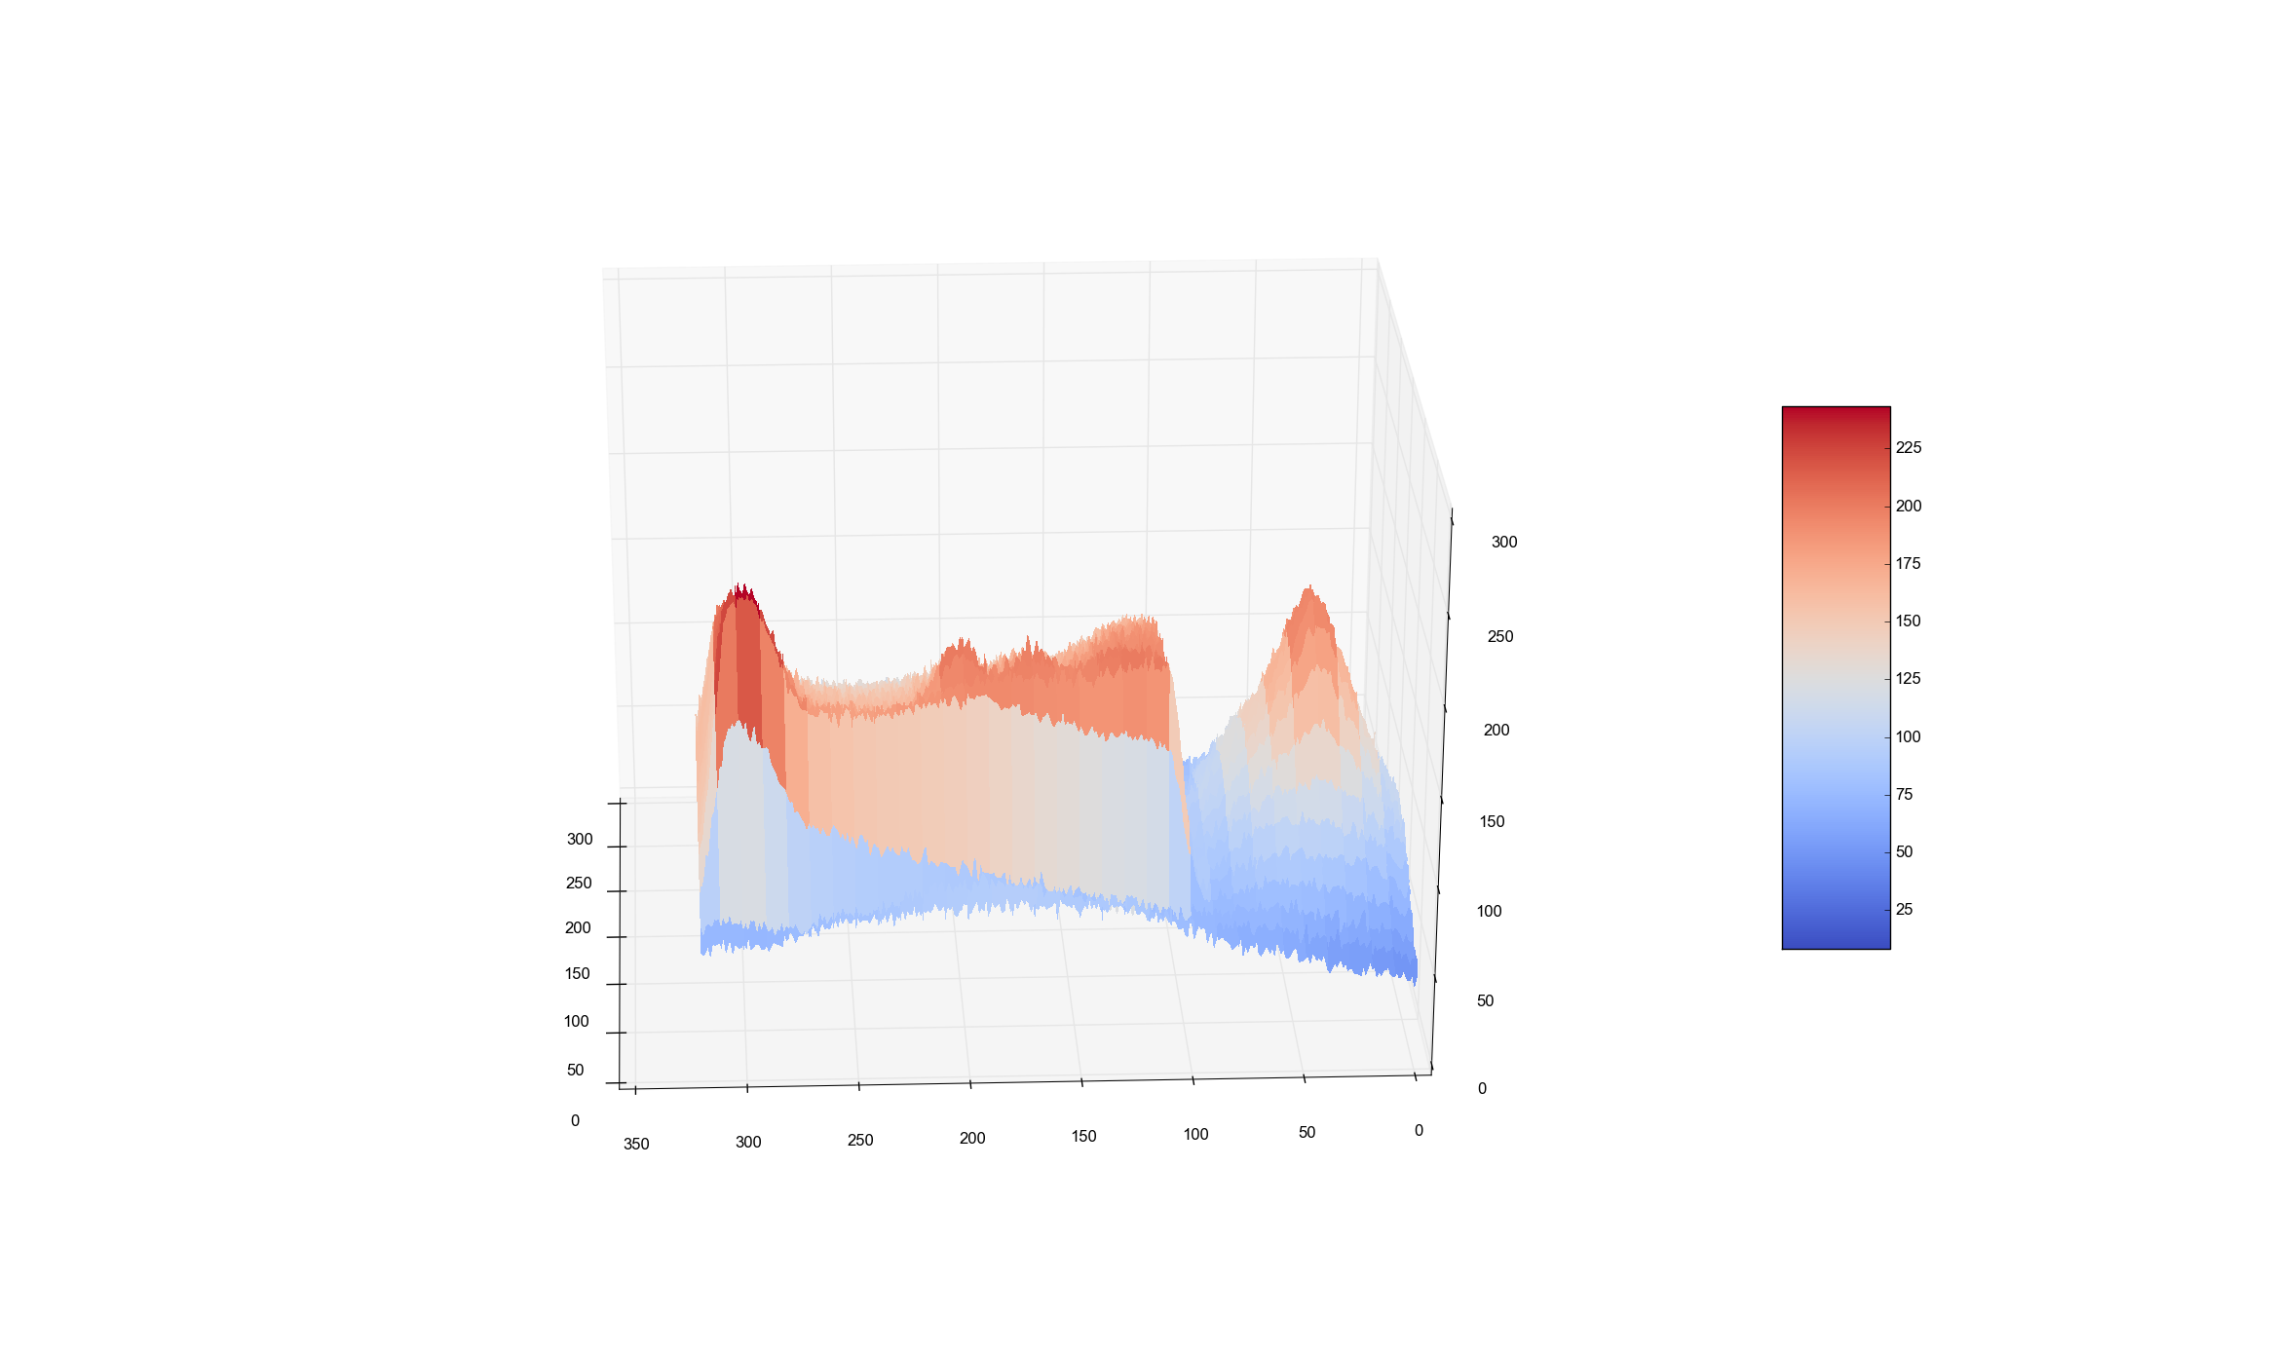
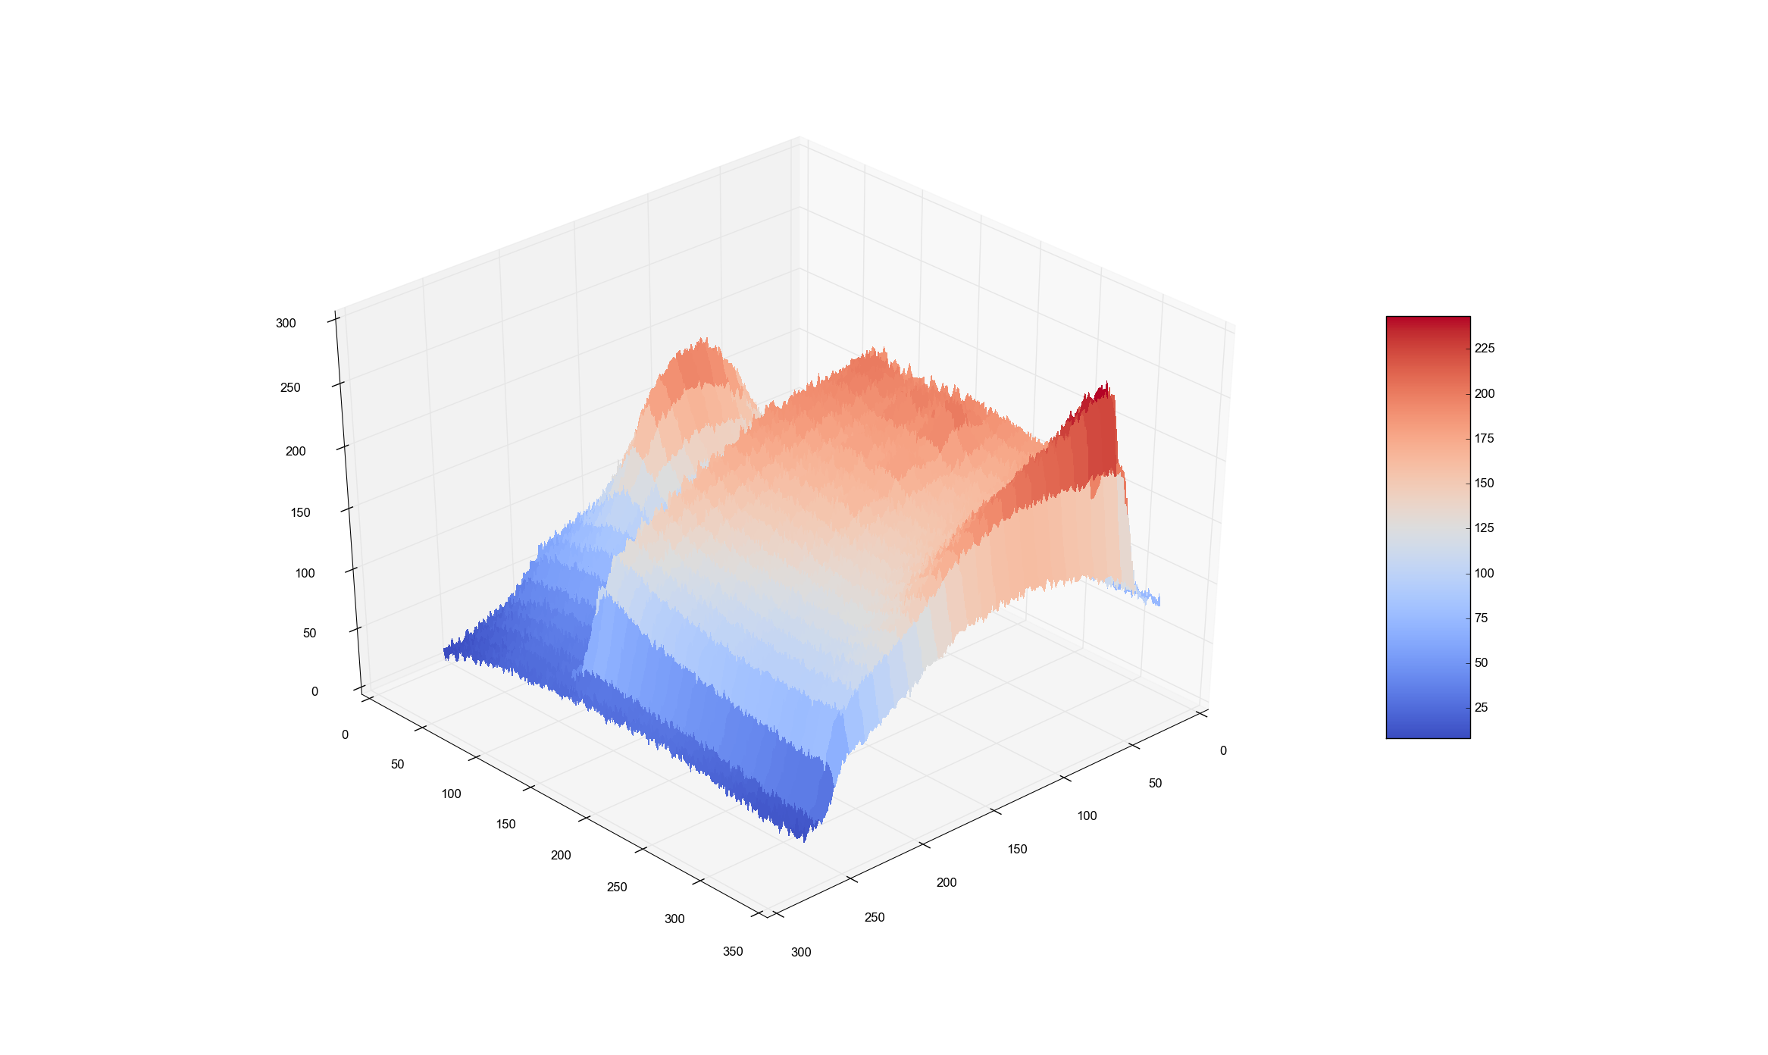
3D plot

Slide 13
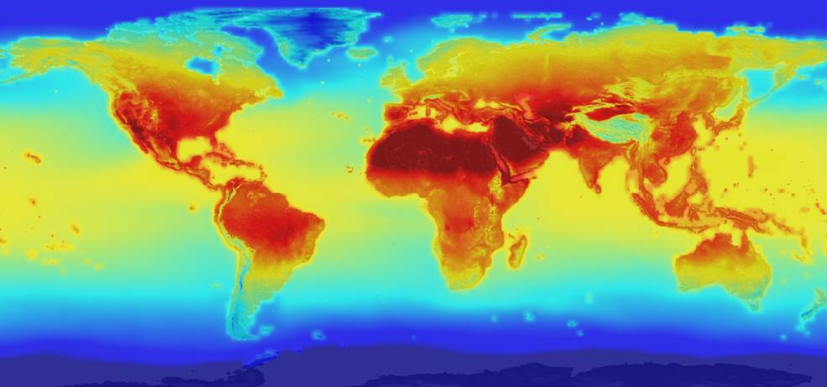
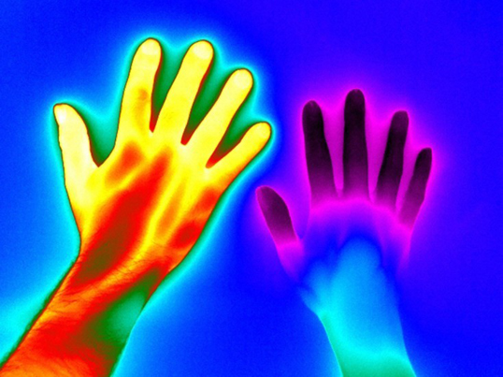
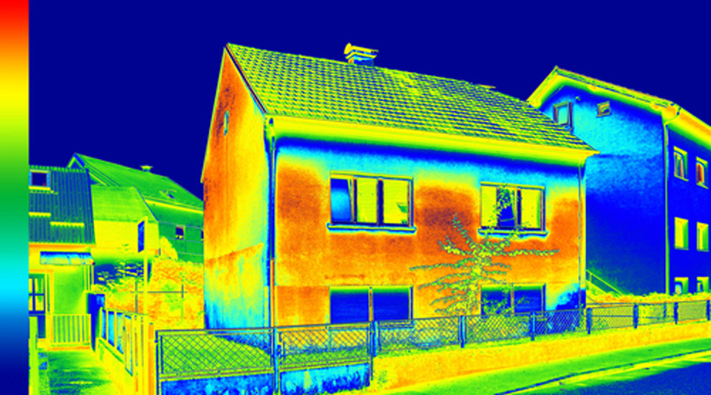
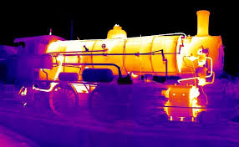
THANK YOU

